Slide 1
SMPS Design Spice Simulations
Date: 11-03-2014

Slide 2
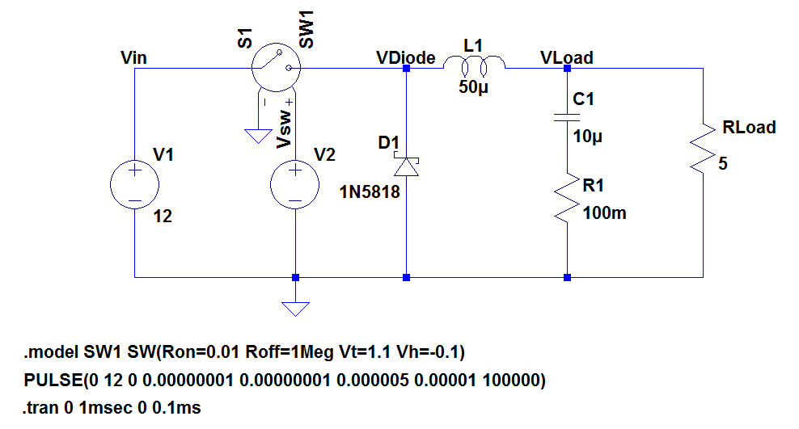
Buck Convertor-1

Slide 3
Points taken from Book
This is a simple buck converter. You can display:
the output voltage V(vout)
the rectangular pulses at the jct diode-inductor: V(SW_D)
the current in the inductor: I(L1)
the current in the capacitor C1: I(C1)
the current in the free-wheel diode D1: I(D1)
Change the value of L1 (100µ or 10µ) and explore CCM and DCM waveforms
Change the capacitor ESR value and see effects on Vout
Buck convertors are used in ATX power supplies used in PCs.

Slide 4
Design parameters
Vin = 12V
Vsw = 12V (Ron=0.01 Roff=1Meg Vt=1.1 Vh=-0.1)
L = 50uH
C = 10uH ESR = 100mohm
Diode = 1N5818
Rload = 5 Ohm

Slide 5
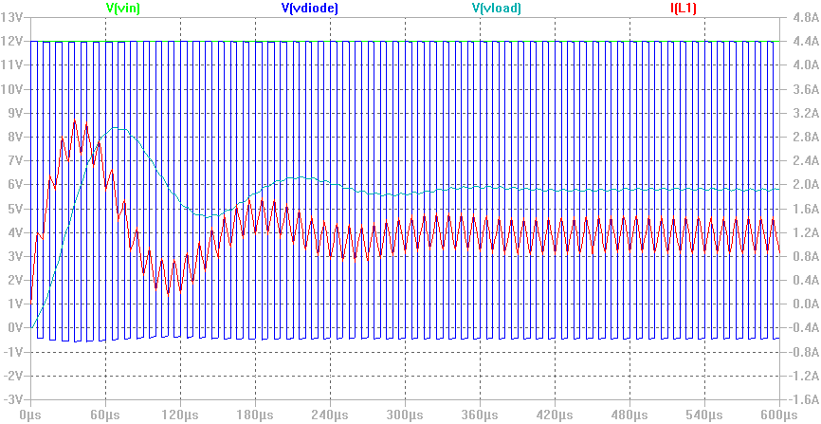
Transient response

Slide 6
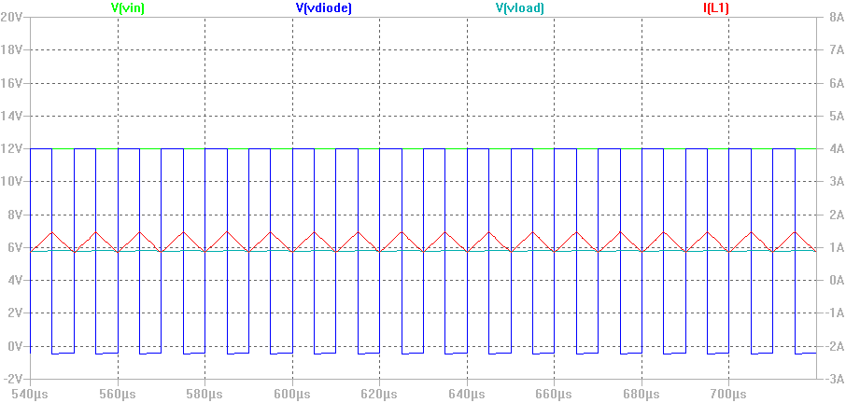
Steady State response
Continuous mode of operation as inductor never goes to zero it always remains charged.

Slide 7
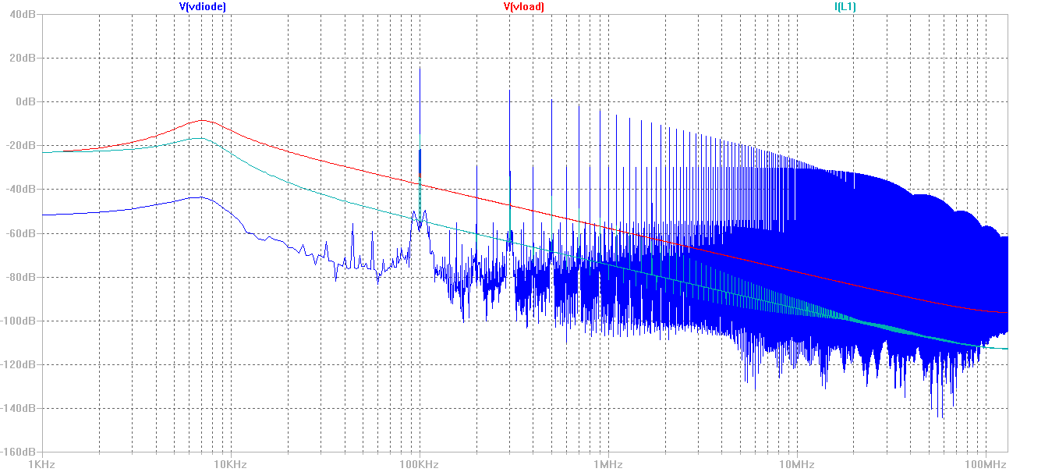
Freq. response

Slide 8
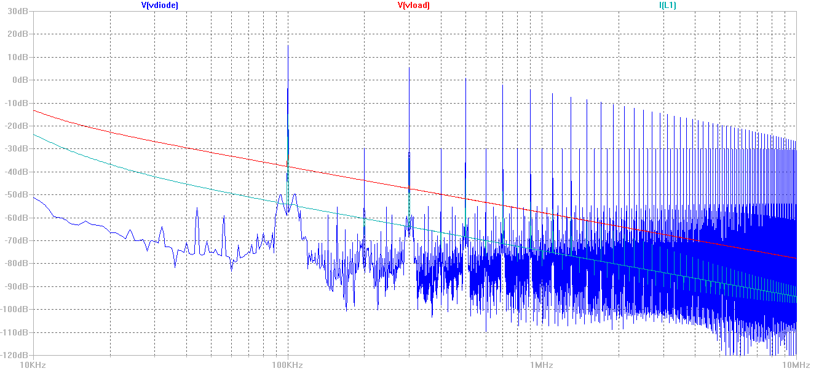
Freq. response Zoomed

Slide 9
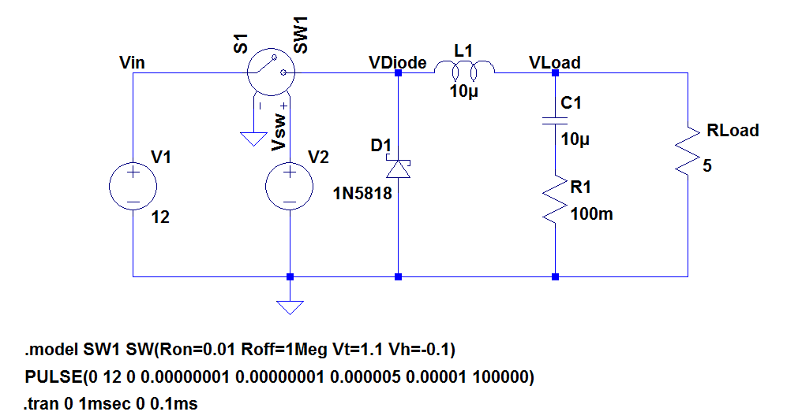
Buck Convertor-2

Slide 10
Design parameters
Vin = 12V
Vsw = 12V (Ron=0.01 Roff=1Meg Vt=1.1 Vh=-0.1)
L = 10uH
C = 10uH ESR = 100mohm
Diode = 1N5818
Rload = 5 Ohm

Slide 11
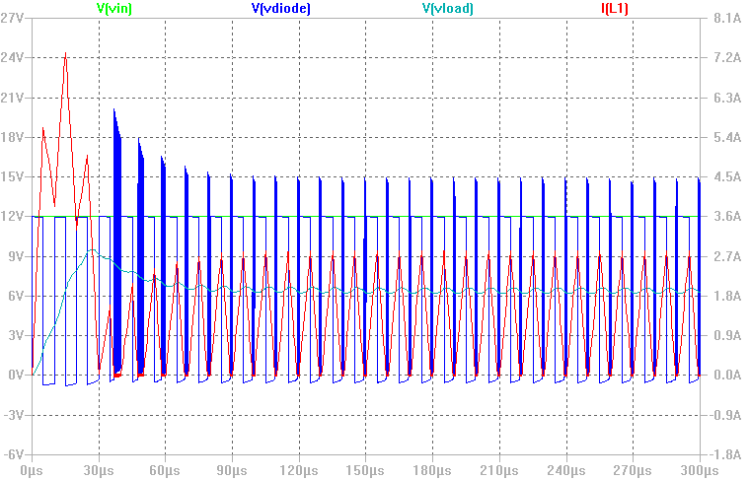
Transient response

Slide 12
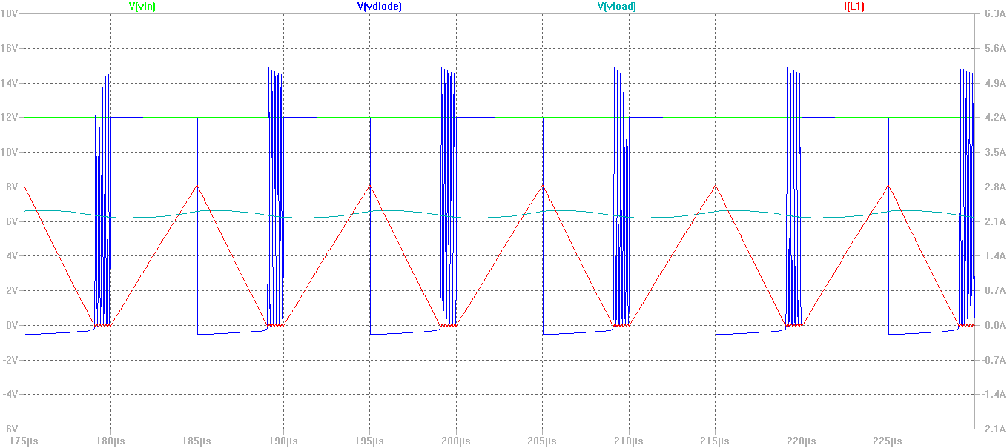
Steady State response
Discontinuous mode of operation as inductor goes to zero. Also Vdiode shoots suddenly.

Slide 13
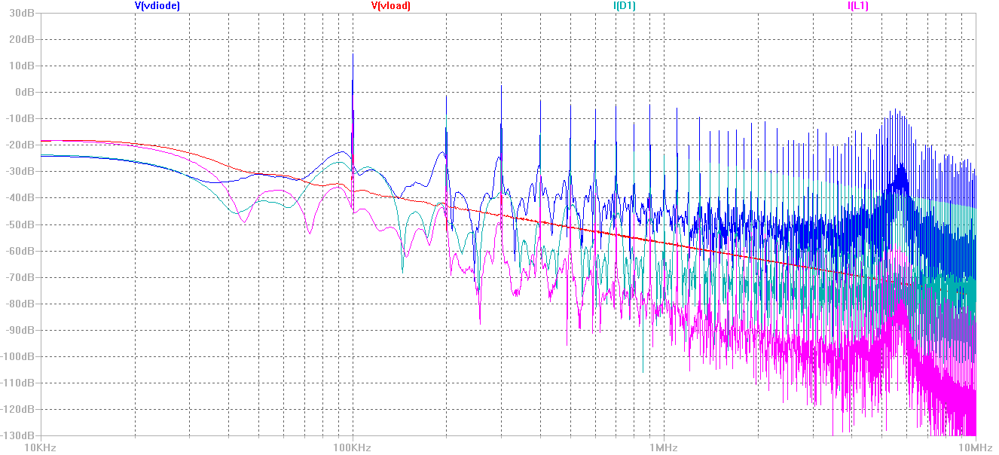
Freq. response Zoomed

Slide 14
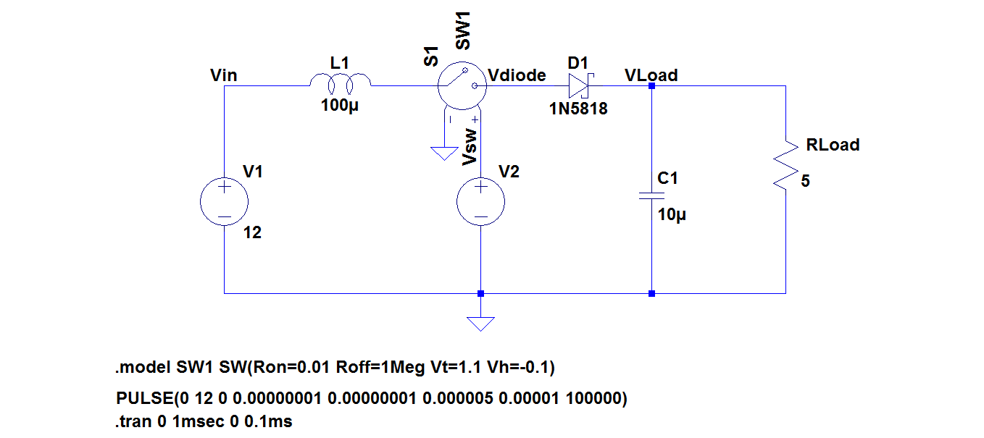
Boost Convertor-1

Slide 15
Design parameters
Vin = 12V
Vsw = 12V (Ron=0.01 Roff=1Meg Vt=1.1 Vh=-0.1)
L = 100uH
C = 10uH ESR = 0 mohm
Diode = 1N5818
Rload = 5 Ohm

Slide 16
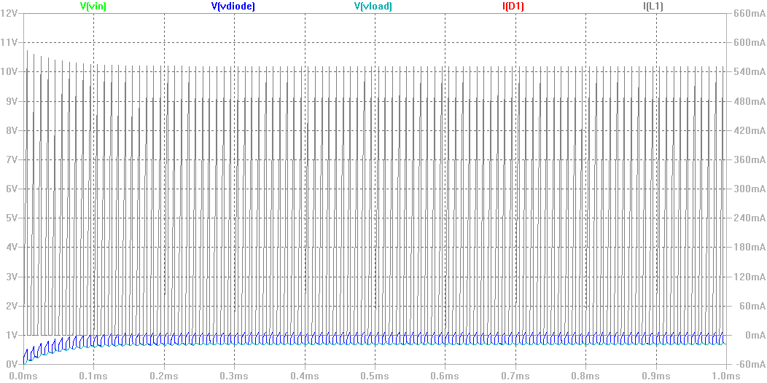
Transient response

Slide 17
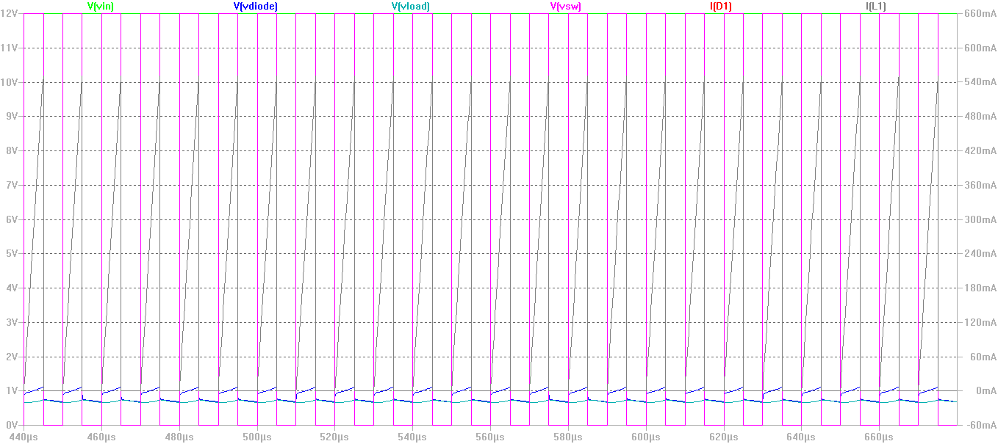
Steady State response
Discontinuous mode of operation as inductor goes to zero. Also Vdiode shoots suddenly.

Slide 18
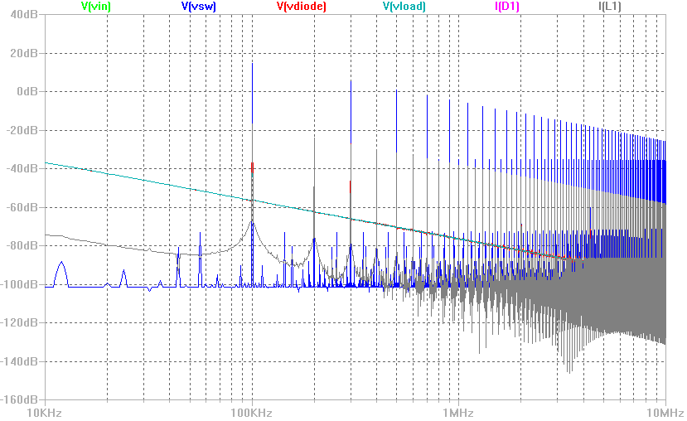
Freq. response Zoomed

Slide 19
Updates: HPF Circuit
Bought EPCOS 0.1uF polypropylene film capacitors with Vrms rating 305V.
Testing a simple HPF circuit with approx values of R on AC voltage and it worked well.
Observations: These capacitors could survive High AC voltages.
Next step is to get some more resistors (33ohm and 75Ohm) from LPR and check output voltage of this circuit on 230Vrms.
Collect some real world data on spectrum analyzer.

